Slide 1
FAT KAT UI DESIN
Skyler Gray

Slide 2

Scratch and claw your way to the top..

Slide 3
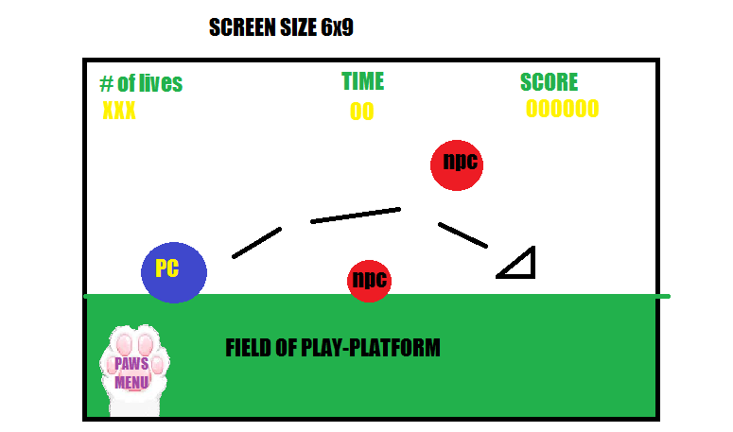
Title and Content Layout with List
2D Ever runner
6x9 screen size

